Slide 1


Data Science Boot Camp
Project: 1
Cohort: Q3 – Q4 2021
Opioid Academic in America
Socio Economic Drivers 2011 - 2017
Curtis Anderson
Kara Humanski
Brian McLane
Joe Rutili
August 2021
Confidential and Proprietary to flamingo labs copyright pending

Slide 2
Null Hypothesis The average income in a county does not affect the number of opioid deaths.
Alternative Hypothesis If the average income in a county is lower the number of opioid deaths will be higher then in counties with higher average incomes.

Slide 3
Data Exploration Steps
Set initial scope to all counties:
Noted middle class data unremarkable due to density
Observed significant correlation in lower- and upper-income segments
Narrowed focus to lowest and highest income segments (target populations)
Analyzed
Deaths per capita by average household income, by income segment
Drug type usage difference by average household income, by income segment
Trends of deaths per capita, by drug type and year of target populations
Deaths per capita state by state and noted remarkable variance in usage by income segment
States with highest number of opioid deaths per capita

Slide 4
Questions
Does average annual household income affect per capita opioid deaths?
What is the break down by opioid type (cause of death) for lowest and highest income segments
What is the trend in opioid deaths among highest and lowest income segments by drug type?
What States of the country have the highest number of deaths?

Slide 5
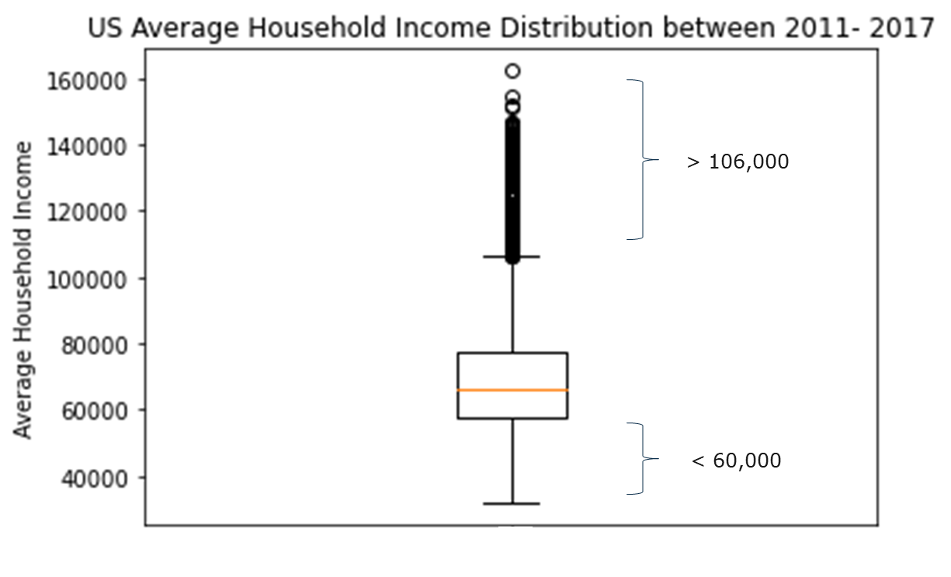
Ttest Results: Pvalue~0.002

Slide 6
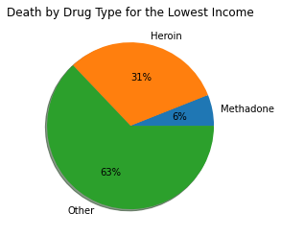
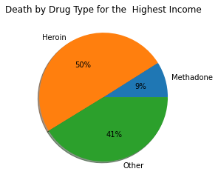
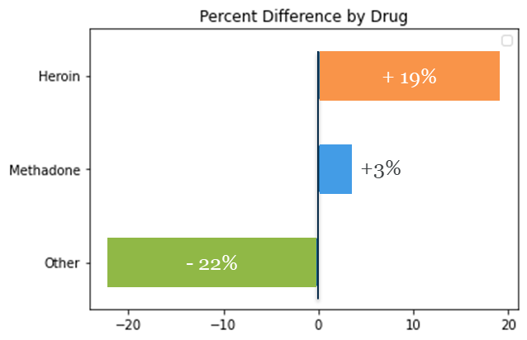

Slide 7
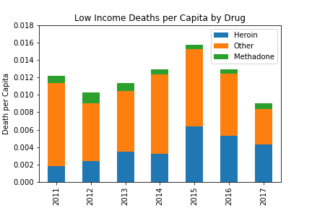
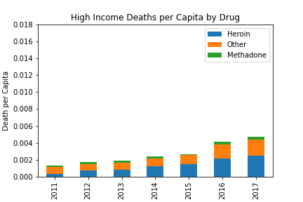
0.018996
0.003351

Slide 8
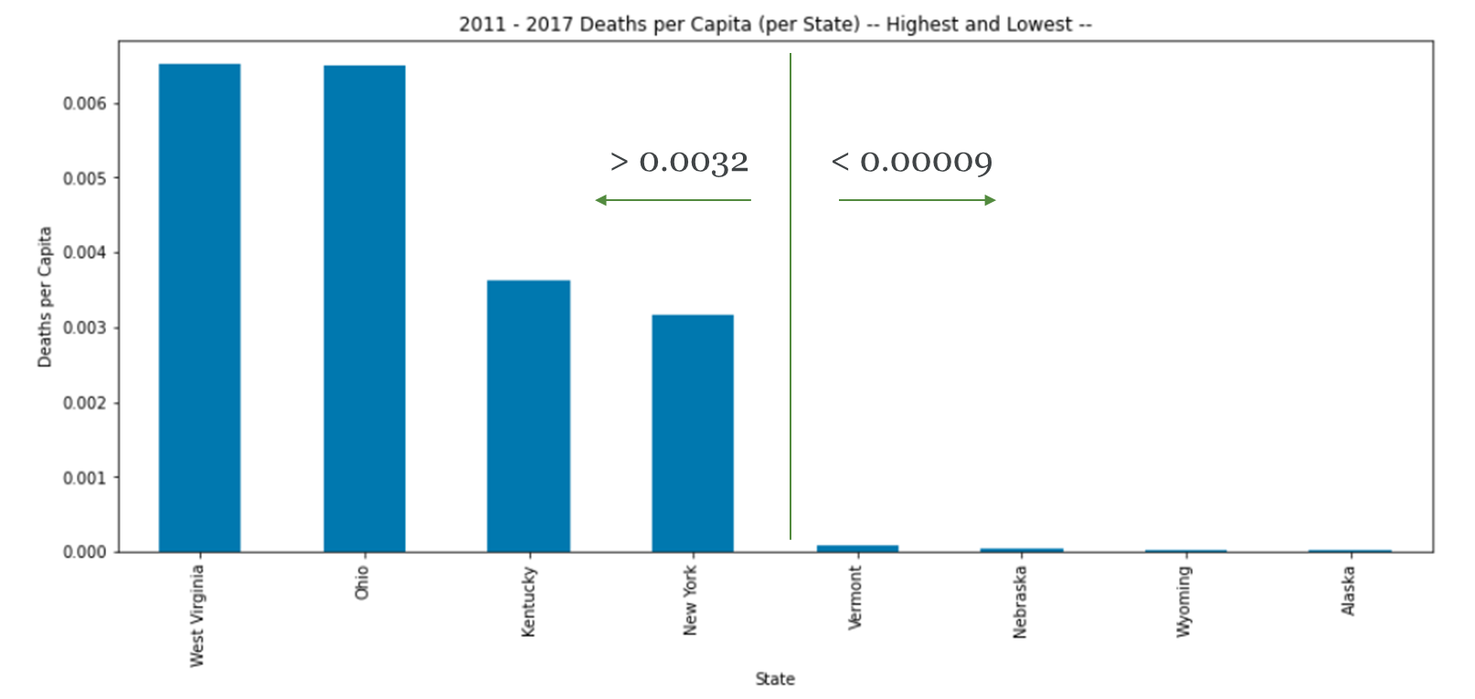

Slide 9
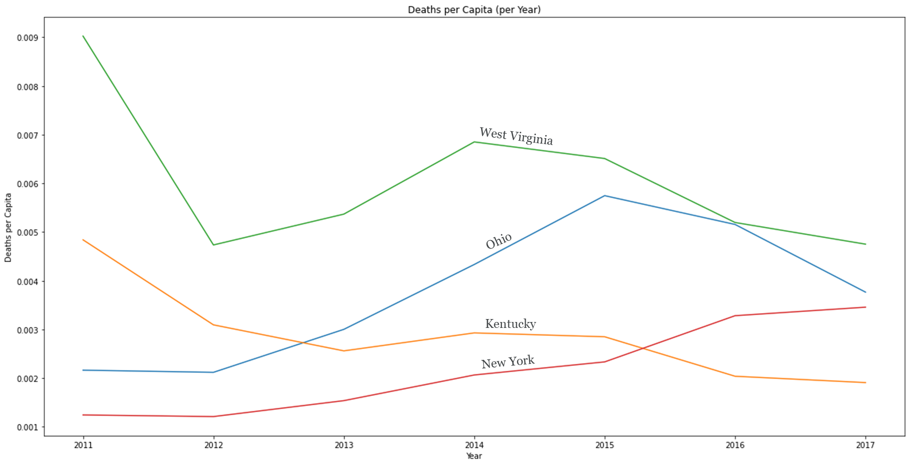

Slide 10
Challenges
Scope Shift
Initial scope included all Counties
Unremarkable data in middle income segments
Shifted to focus on lower- and upper-income segments
Next Steps
Education level impact on average opioid death per capita
GDP-EHSA spending impact on average opioid death per capita
Population density impact on average opioid death per capita
Non-US Born Status impact on average opioid death per capita
Scope expansion to include international populations
Drill down into Opioid categories

